Slide 1
Machine Learning for Methane Adsorption Capacity Prediction in Metal Organic Frameworks
Presented by GUPTA AVANI (G2303786B)

Slide 2

Methane
Excellent candidate for alternative transport fuel
Abundant
Clean burning process
Largest combustion energy released per unit carbon dioxide emitted
BUT…
Responsible for 30% of the rise in global temperature
GWP of 83 times that of carbon dioxide
Need for development of
methane capture systems!

Slide 3

The Problem
The Solution
Zeolites
Metal Organic Frameworks
Aluminosilicate minerals containing alkali and alkaline earth metals
CH₄ uptake of only ~ 100 cm³
3D networks of organic ligands with metal sites
Versatile and tunable structures
CH₄ uptake >> 100 cm³

Slide 4
The Problem
The Solution
GCMC Simulations
Machine Learning
Large number of potential MOF structures
Computationally expensive and time-taking
Need for complex and specialized software (RASPA, poreblazer, Zeo++)
High accuracy
Quick response
Low computational cost
User-friendly

Slide 5
Dataset Features
Pore Limiting Diameter
Largest Cavity Diameter
In Angstroms
Diameter of smallest opening - determines what size of molecules can enter
In Angstroms
Diameter of largest cavity - determines no. and/or size of molecules that will fit in a pore
Gravimetric Surface Area
Volumetric Surface Area
In m²/g
Surface area per unit mass
In m²/cm³
Surface area per unit volume

Slide 6
Dataset Features
Density
Void Fraction
In g/cm³
Mass per unit volume
Porosity
Ratio of volume of pores to volume of material
Pore Volume
Probes 1, 2, 3 & 4
In cm³/g
Total volume of pores per unit mass of material
Energy-based descriptors
Average value of Boltzmann factor at all positions

Slide 7
Target Variable
5.8 bars
1 bar
65 bars
Methane Adsorption Capacity
Adsorption capacity of metal organic frameworks for methane at constant temperature of 298 K and different pressures.

Slide 8
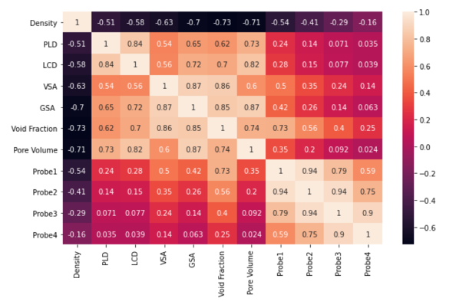
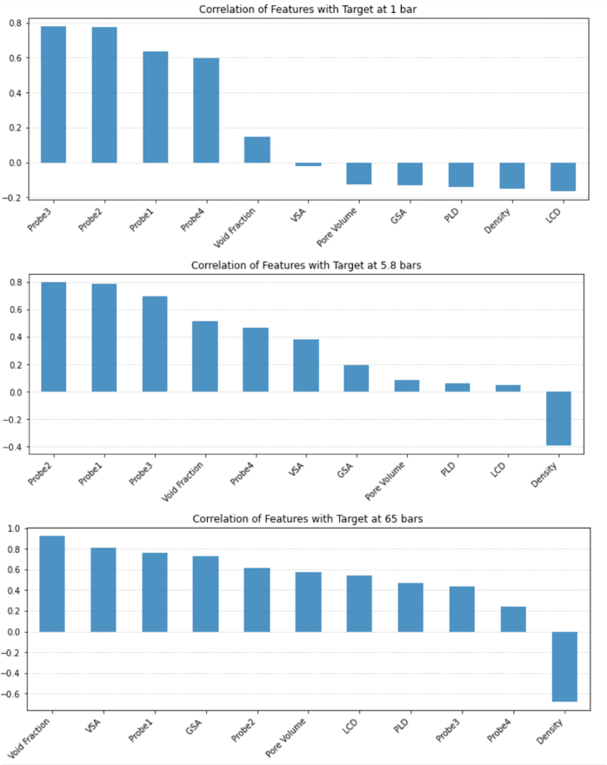
Feature Correlation
Key findings:
At low pressures - Energy-based descriptors are most strongly correlated with target.
At high pressures - Void fraction and VSA are most strongly correlated with target.

Slide 9
ML Algorithms Used
Lasso Regressor
Decision Tree Regressor
Performs feature selection, reduces model complexity
Non-linear, easy to interpret
Support Vector Regressor
Random Forest Regressor
Non-linear model, robust to outliers
High accuracy, reduces overfitting, robust to outliers and noise

Slide 10
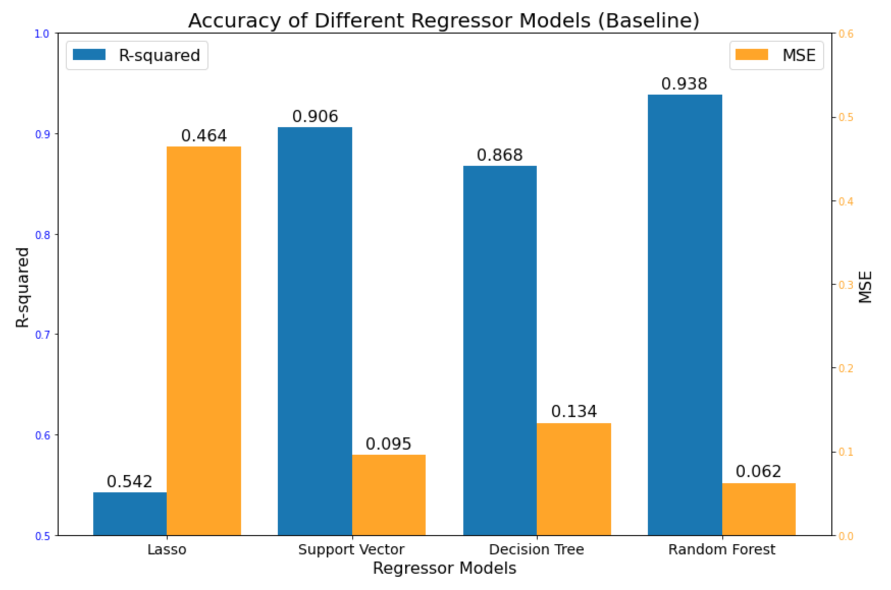
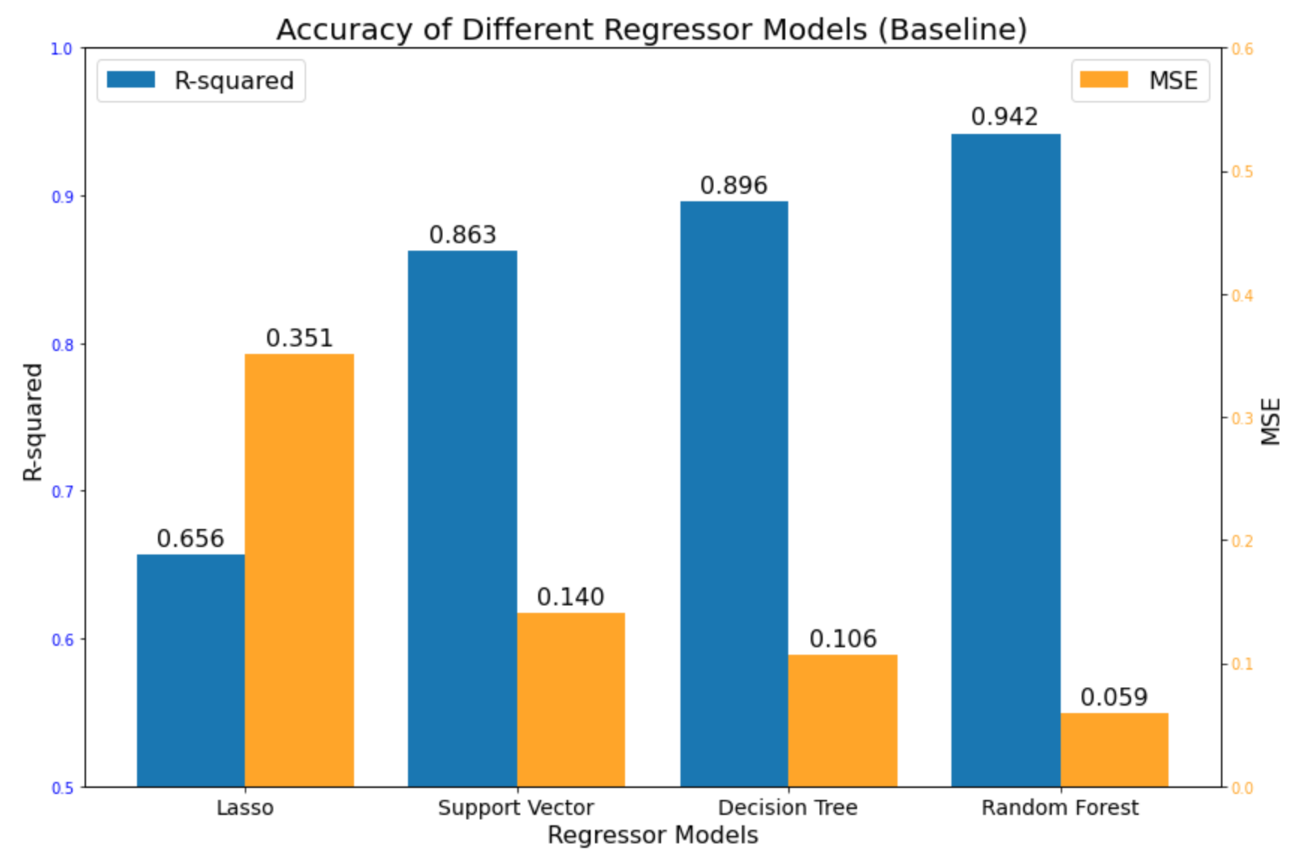
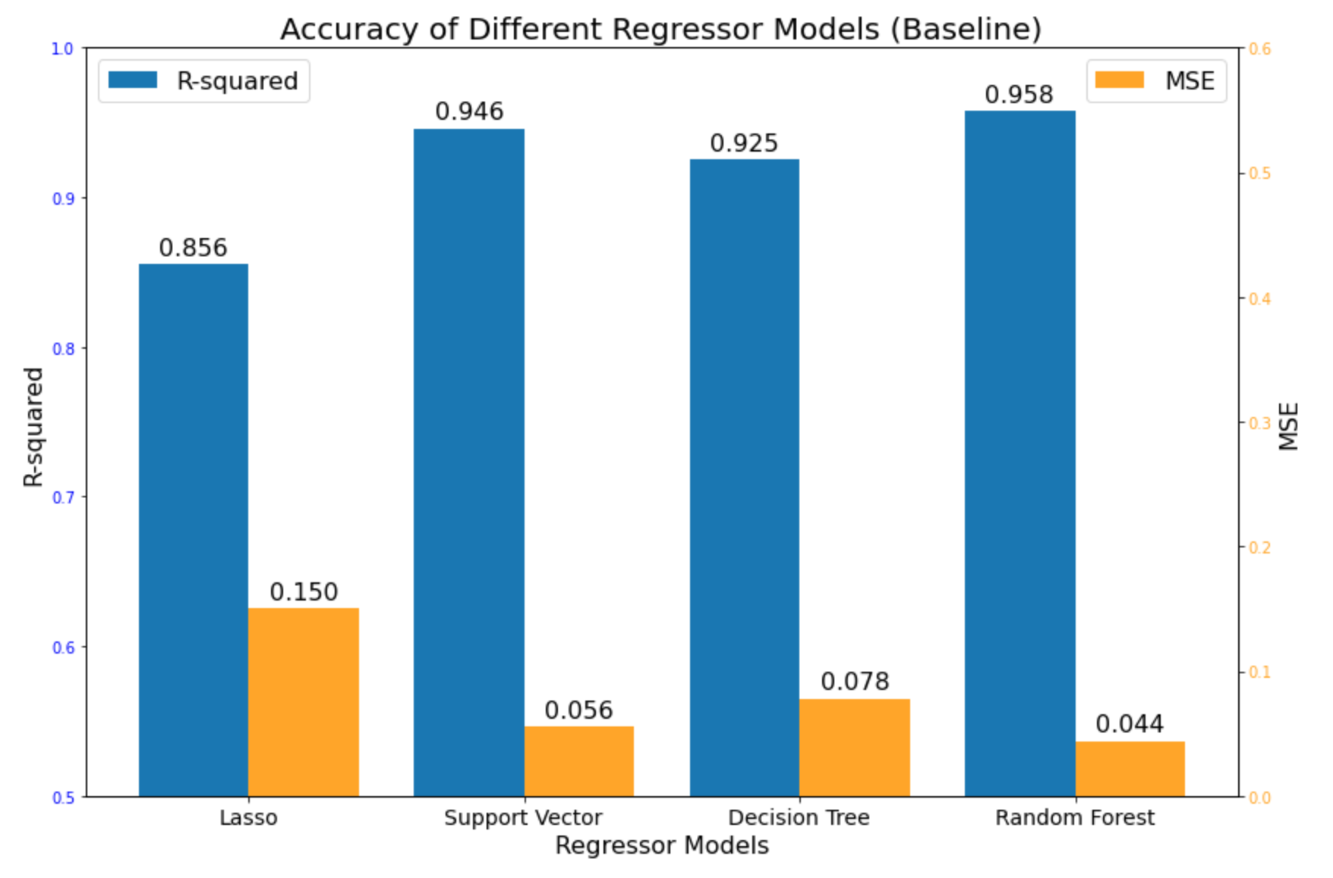
Model Performance
1 bar
5.8 bars
65 bars
Random Forest Model performed better than others at all pressures.

Slide 11
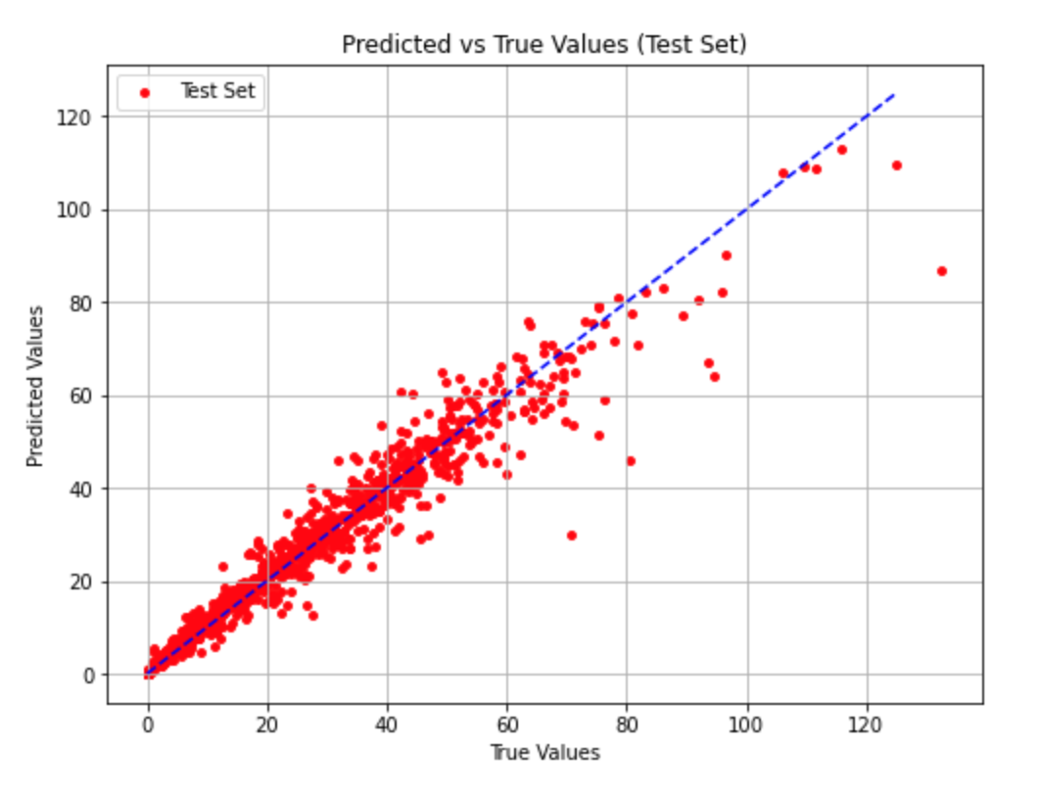
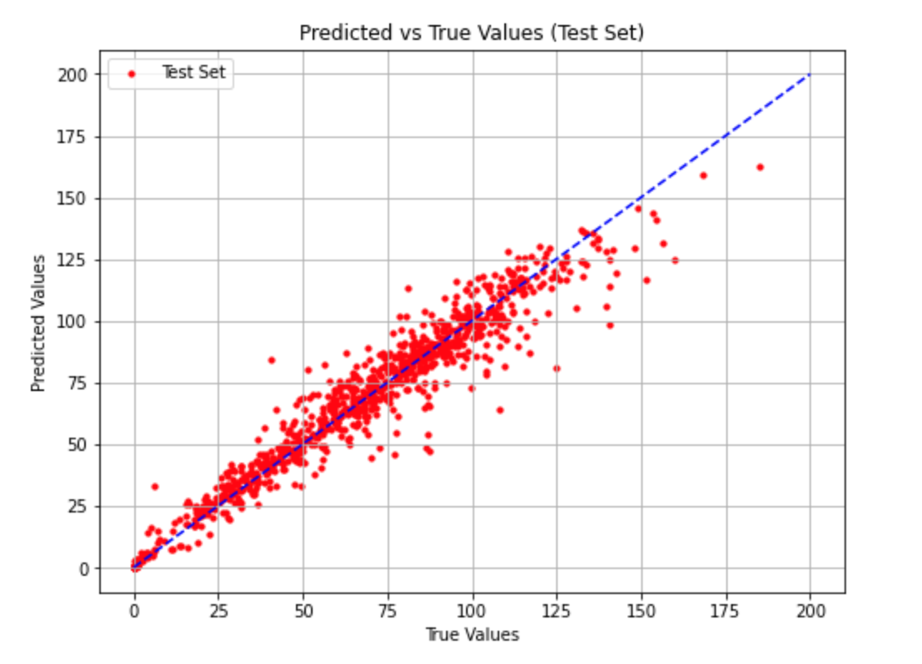
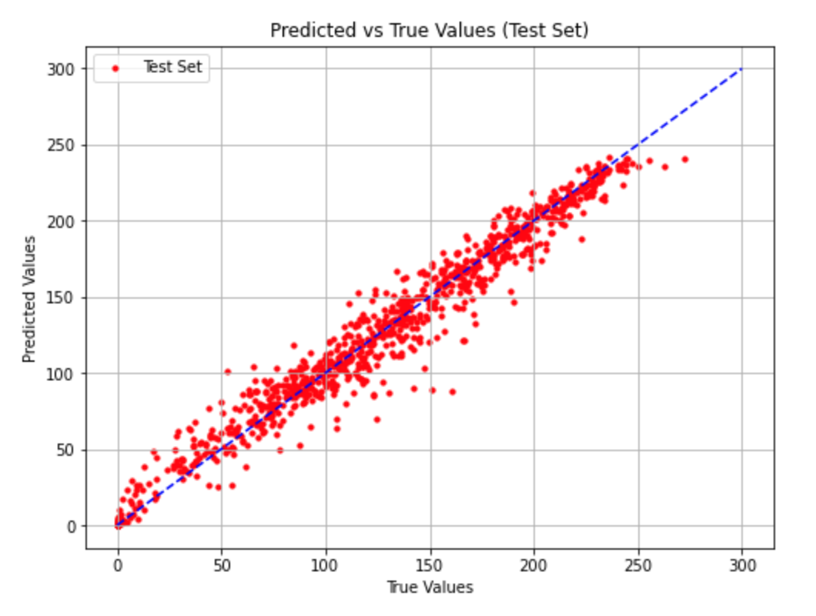
Model Performance
1 bar
5.8 bars
65 bars
R² - 0.944
MSE - 0.057
R² - 0.939
MSE - 0.062
R² - 0.960
MSE - 0.042

Slide 12
Feature Importance Analysis
1 bar
5.8 bars
65 bars
Probe 3
Probe 2
Probe 4
Probe 3
Probe 2
Void Fraction
Void Fraction
GSA
VSA
Energy-based descriptors dominate at lower pressures, whereas structural descriptors are more important at higher pressures.
Insights on pressure-dependent gas adsorption mechanism.
Similar to feature correlation with target.

Slide 13
Applications & Significance
Applications of ML Model
Industrial & Environmental Significance
Material selection for MCS design
Better understanding of the adsorption process
Tune to predict adsorption of other gases
Guide and aid experimental research
Lesser concentration of methane in atmosphere
Increased use of methane as transport fuel

Slide 14
Conclusion
ML for Capacity Prediction
Quick, user-friendly and low computational cost.
Random Forest & its Accuracy
Best performance at all pressures with accuracy > 93%.
Significance
Leads to a more environmentally conscious world.
Future Work
Explore chemical descriptors and unsupervised and reinforcement algorithms.

Slide 15
References
Fanourgakis, G. S., Gkagkas, K., Tylianakis, E., Klontzas, E., & Froudakis, G. (2019). A robust machine learning algorithm for the prediction of methane adsorption in nanoporous materials. The Journal of Physical Chemistry A, 123(34), 6080-6087. https://doi.org/10.1021/acs.jpca.9b04339.​
Feng, W., Sui, H., Tu, J., Huang, W., & Sun, K. (2018). A novel change detection approach based on visual saliency and random forest from multi-temporal high-resolution remote-sensing images. International Journal of Remote Sensing, 39(22), 1-24. https://doi.org/10.1080/01431161.2018.1479794.​
He, Y.; Zhou, W.; Qian, G.; Chen, B. Methane Storage in Metal–Organic Frameworks. Chem. Soc. Rev. 2014, 43 (16), 5657–5678. https://doi.org/10.1039/C4CS00032C.​
Wu, H.; Simmons, J. M.; Liu, Y.; Brown, C. M.; Wang, X.-S.; Ma, S.; Peterson, V. K.; Southon, P. D.; Kepert, C. J.; Zhou, H.-C.; Yildirim, T.; Zhou, W. Metal–Organic Frameworks with Exceptionally High Methane Uptake: Where and How is Methane Stored? Chem. – Eur. J. 2010, 16 (17), 5205–5214. https://doi.org/10.1002/chem.200902719.​
Machine Learning Using Combined Structural and Chemical Descriptors for Prediction of Methane Adsorption Performance of Metal Organic Frameworks (MOFs) | ACS Combinatorial Science. https://pubs.acs.org/doi/10.1021/acscombsci.7b00056 ​
Global Warming Potential. Wikipedia; 2024.​
Review and Analysis of Molecular Simulations of Methane, Hydrogen, and Acetylene Storage in Metal–Organic Frameworks | Chemical Reviews. https://pubs.acs.org/doi/full/10.1021/cr200217c ​

Slide 16
Thank you!

